Slide 1
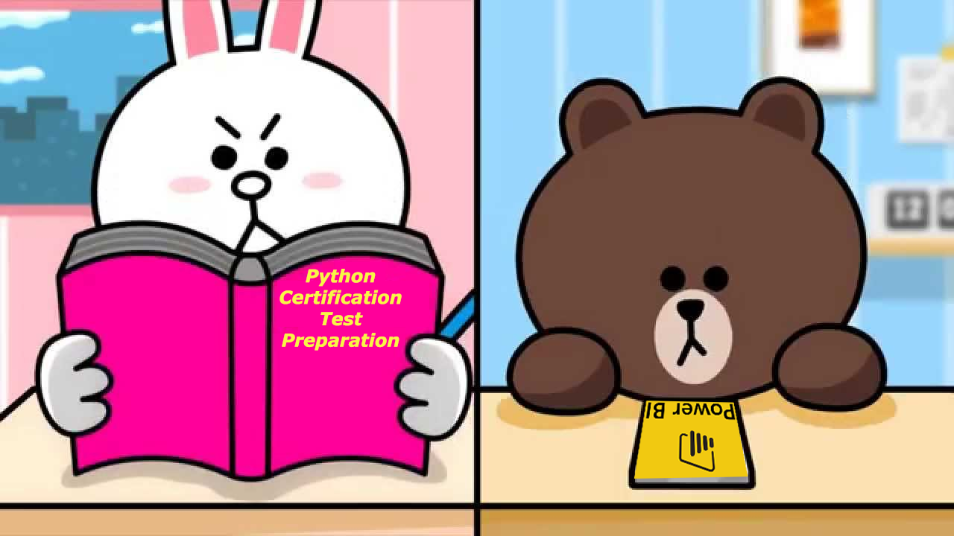
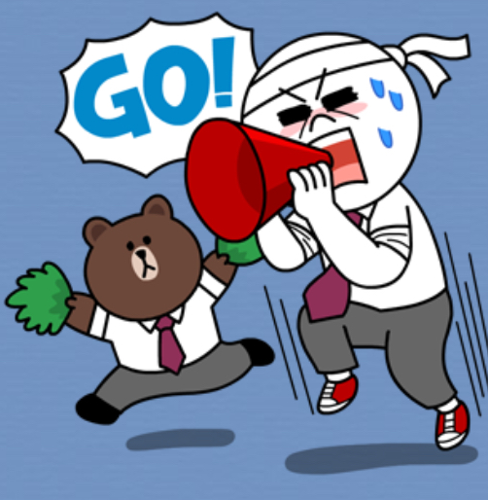

Slide 2
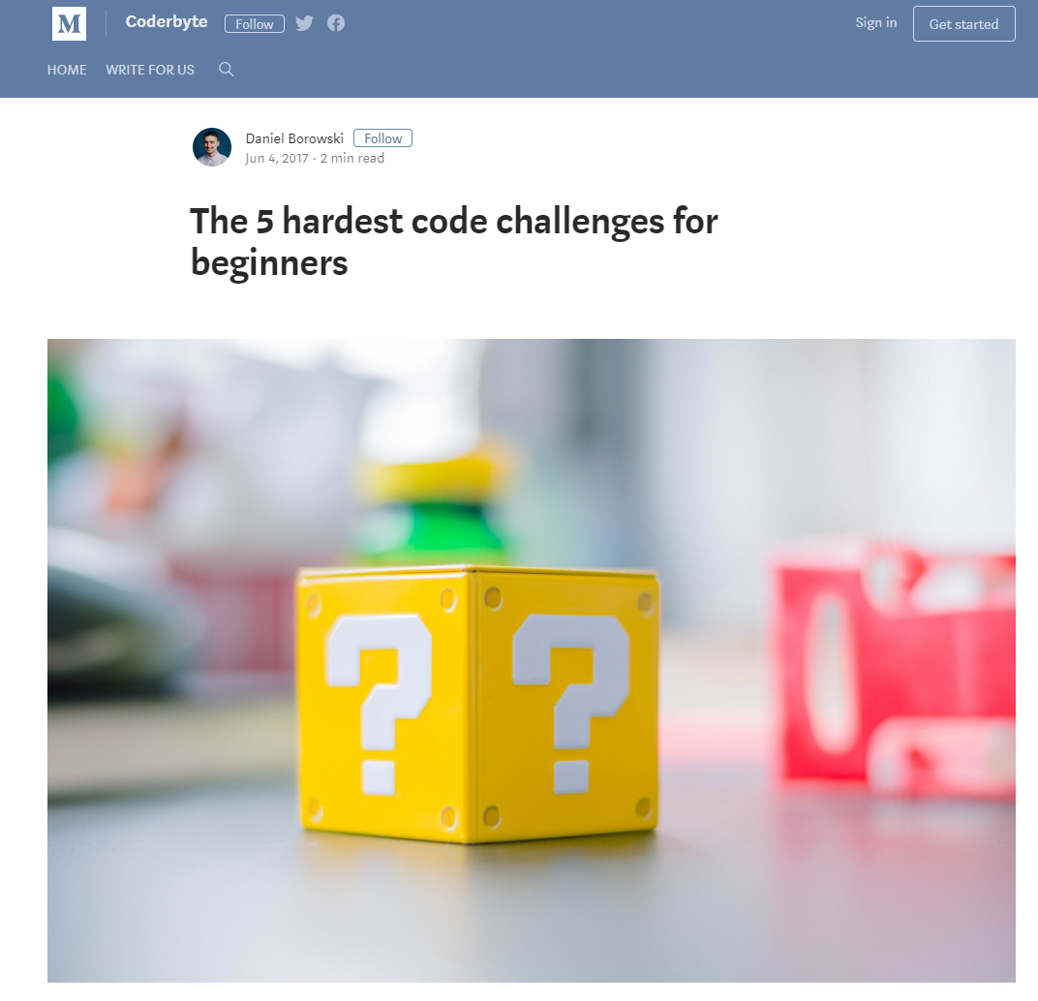
THE HANDS-ON IMPERATIVE
Submit your work to:
Your GITHUB Repository
And email the Instructor the LINK

Slide 3

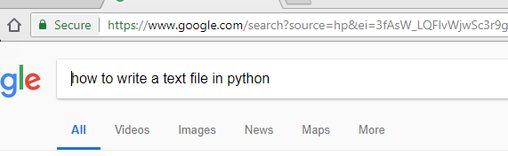
One of the Big Challenges in this Hackathon is LEARNING HOW TO TEACH YOURSELF NEW THINGS!

Slide 4
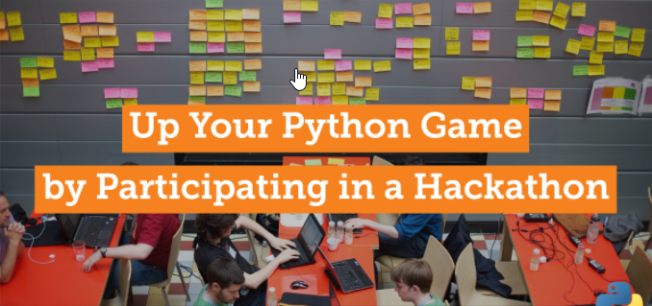

Slide 5

Each Team will receive 4 Challenges
You will receive 25% for each challenge completed successfully.
Partial Marks MAY be awarded for partial but not complete code

Slide 6
Challenge 1: Write a Python Program to collect all team members names and student numbers from the command line and write them out to a Text File
Save your File as Challenge1.py
[Name your Project Directory: Hackathon_S18 ]
Your Output File is called: Challenge1_output.py
Submit your work to:
Your GitHub Repository

Slide 7
Challenge 2: Add the first 100 integers
For Loops are written in the following format:
for i in range(1,10):
#do something!!!

Slide 8
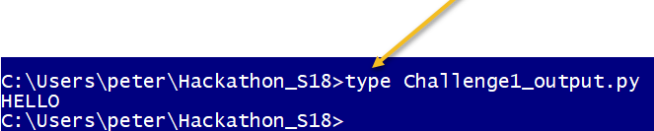
HINTS:

Slide 9
Challenge 3: Recursion
Using this definition for a RECURSIVE FUNCTION,
Print out the factorials of the numbers: 1 to 10
For Loops are written in the following format:
def factorial(n):
if n == 1:
return 1
else:
return n * factorial(n-1)
for i in range(1,10):
#do something!!!
Recursion is a way of programming or coding a problem, in which a function calls itself one or more times in its body. Usually, it is returning the return value of this function call. If a function definition fulfils the condition of recursion, we call this function a recursive function. Termination condition: A recursive function has to terminate to be used in a program. A recursive function terminates, if with every recursive call the solution of the problem is downsized and moves towards a base case. A base case is a case, where the problem can be solved without further recursion. A recursion can lead to an infinite loop, if the base case is not met in the calls.

Slide 10

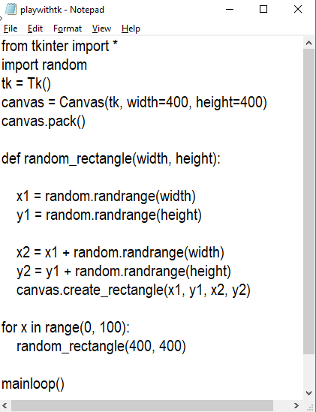
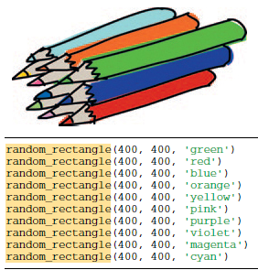
Extend this starter code to change the background color of the Canvas, using the example code shown on the right:

Slide 11
Answer to Challenge 1
f = open('Challenge1_output.txt','w')
f.write("HELLO!")
f.write(" type aaa to end entry of team members' names")
print(" type aaa to end entry of team members' names")
keepgoing = 'y'
while (keepgoing == 'y'):
teammembername = input("State Team Member's Name and Student number in the form Name-StudentNumber: ")
f.write(teammembername + "\n")
print(' you entered ', teammembername )
if (teammembername == 'aaa'):
keepgoing = 'n'
f.close()

